Slide 1


  Increase Store Profits – Nestle Fully Funds promotion – Store Margin increases to 69%
  Crunch Dibs and Butterfinger Bites increased APSD to $5.69 when on Promotion
  Nestle Drives traffic to 7-Eleven -Butterfinger Bites is capitalizing on the proven powerhouse Butterfinger brand that has top selling confections offerings with Marketing/Media Candy Halo on the Brand
  Leveraging the success of Dibs in the bite size, Popables form which is ideal for the immediate consumption purchaser at 7-Eleven.
Nestle Butterfinger Bites & Crunch Dibs 2/$4
P4: Ice Cream
CSA
Why Carry
Single Serve Ice Cream Snacks
Consumer trends evolving in consumers interest in mini desserts, over 50% of consumers want a mini dessert throughout their day.
  Penetration of bite sized product has increased 15.6% (CAGR 4 Years)
  Differentiated size offerings in the bunker provide incremental sales to the variety seeking ice cream category
  Dibs continues to be the #1 bite size/Popables ice cream snack offering
Crunch Dibs & Butterfinger Bites 2/$4 LY grew sales by 34%
Crunch Dibs is the #6 Novelty item and Butterfinger is #26 and only in 50% of the stores
Financial Opportunity
Store Execution Steps
Action Steps:
2/$4 offer is mix and match of
either Flavor
Mark SKU’s as Carried in the WMC
Update minimums for Summer Selling
Forecast aggressively: Expect 35% Lift
Ensure both flavors are next to each other in Novelty section
POP: Static Cling near Crunch Dibs & Butterfinger Bites
SLIN Description
Crunch Dibs 190225
Butterfinger Bites 191229
** All costs/retail are national averages. Please refer to the ISP for exact cost/retail by store.

Slide 2
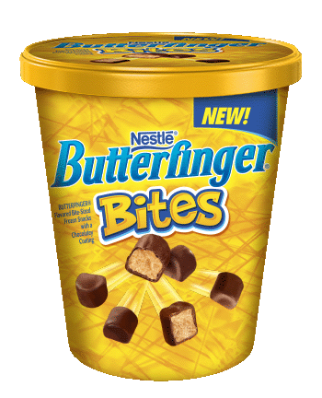
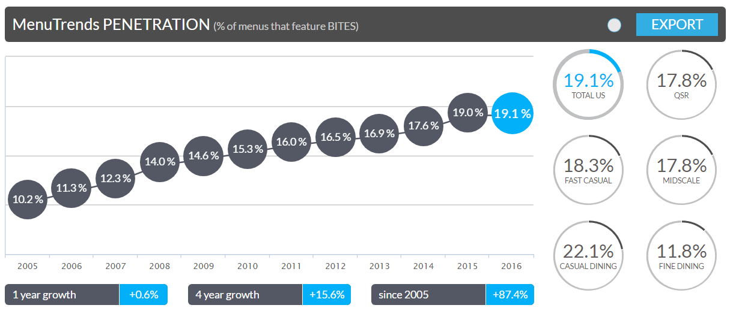
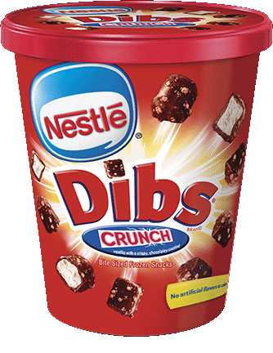
Why Dibs & Bites?
Top menu trends
Penetration of bite sized product has increased 15.6% (CAGR 4 Years)
Over half o consumers are highly interested in mini desserts
Differentiated size offerings in the bunker provide incremental sales to the variety seeking ice cream category
Collaboratively develop Butterfinger centric promotional activities to drive awareness and trial of both confection items and Dibs & Bites in the bunker
Continued Butterfinger new innovation/launch deliver brand halo back to IC category

Slide 3


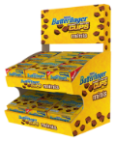
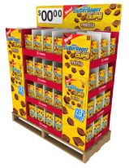





Nestlé Butterfinger is a Powerhouse brand with year-round support!
+
Notes:
Leveraging the success of the Butterfinger confections brand which has been around for over 90 years! A $139MM business in 2013, it is 2.5x the size of the Crunch confection brand!¹
Confections NEW Butterfinger Cups velocities are nearly double the avg Butterfinger SKU! Proving sometimes all you need is a dose of Butterfinger.²

Slide 4


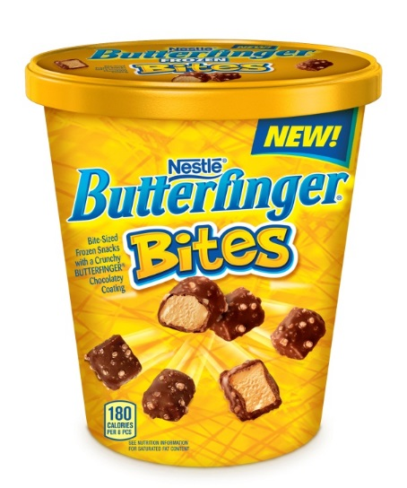
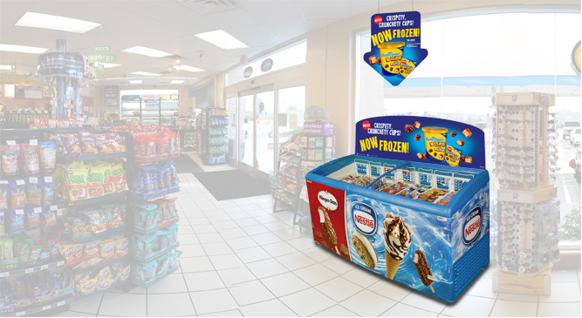
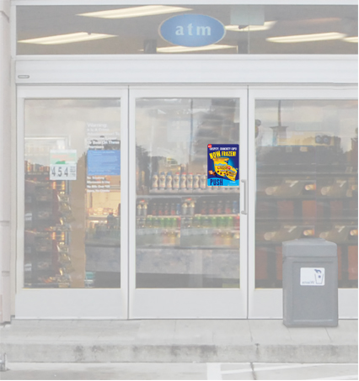
Bringing nestlé butterfinger® to the Ice cream portfolio!
Incredible Butterfinger inspired Singles offering in our top selling bites form!
Butterfinger Cups Minis*
1/12/4 oz
$2.89 SRP
Confections and ice cream cross promotional opportunity with strength of Butterfinger branding!

